Slide 1
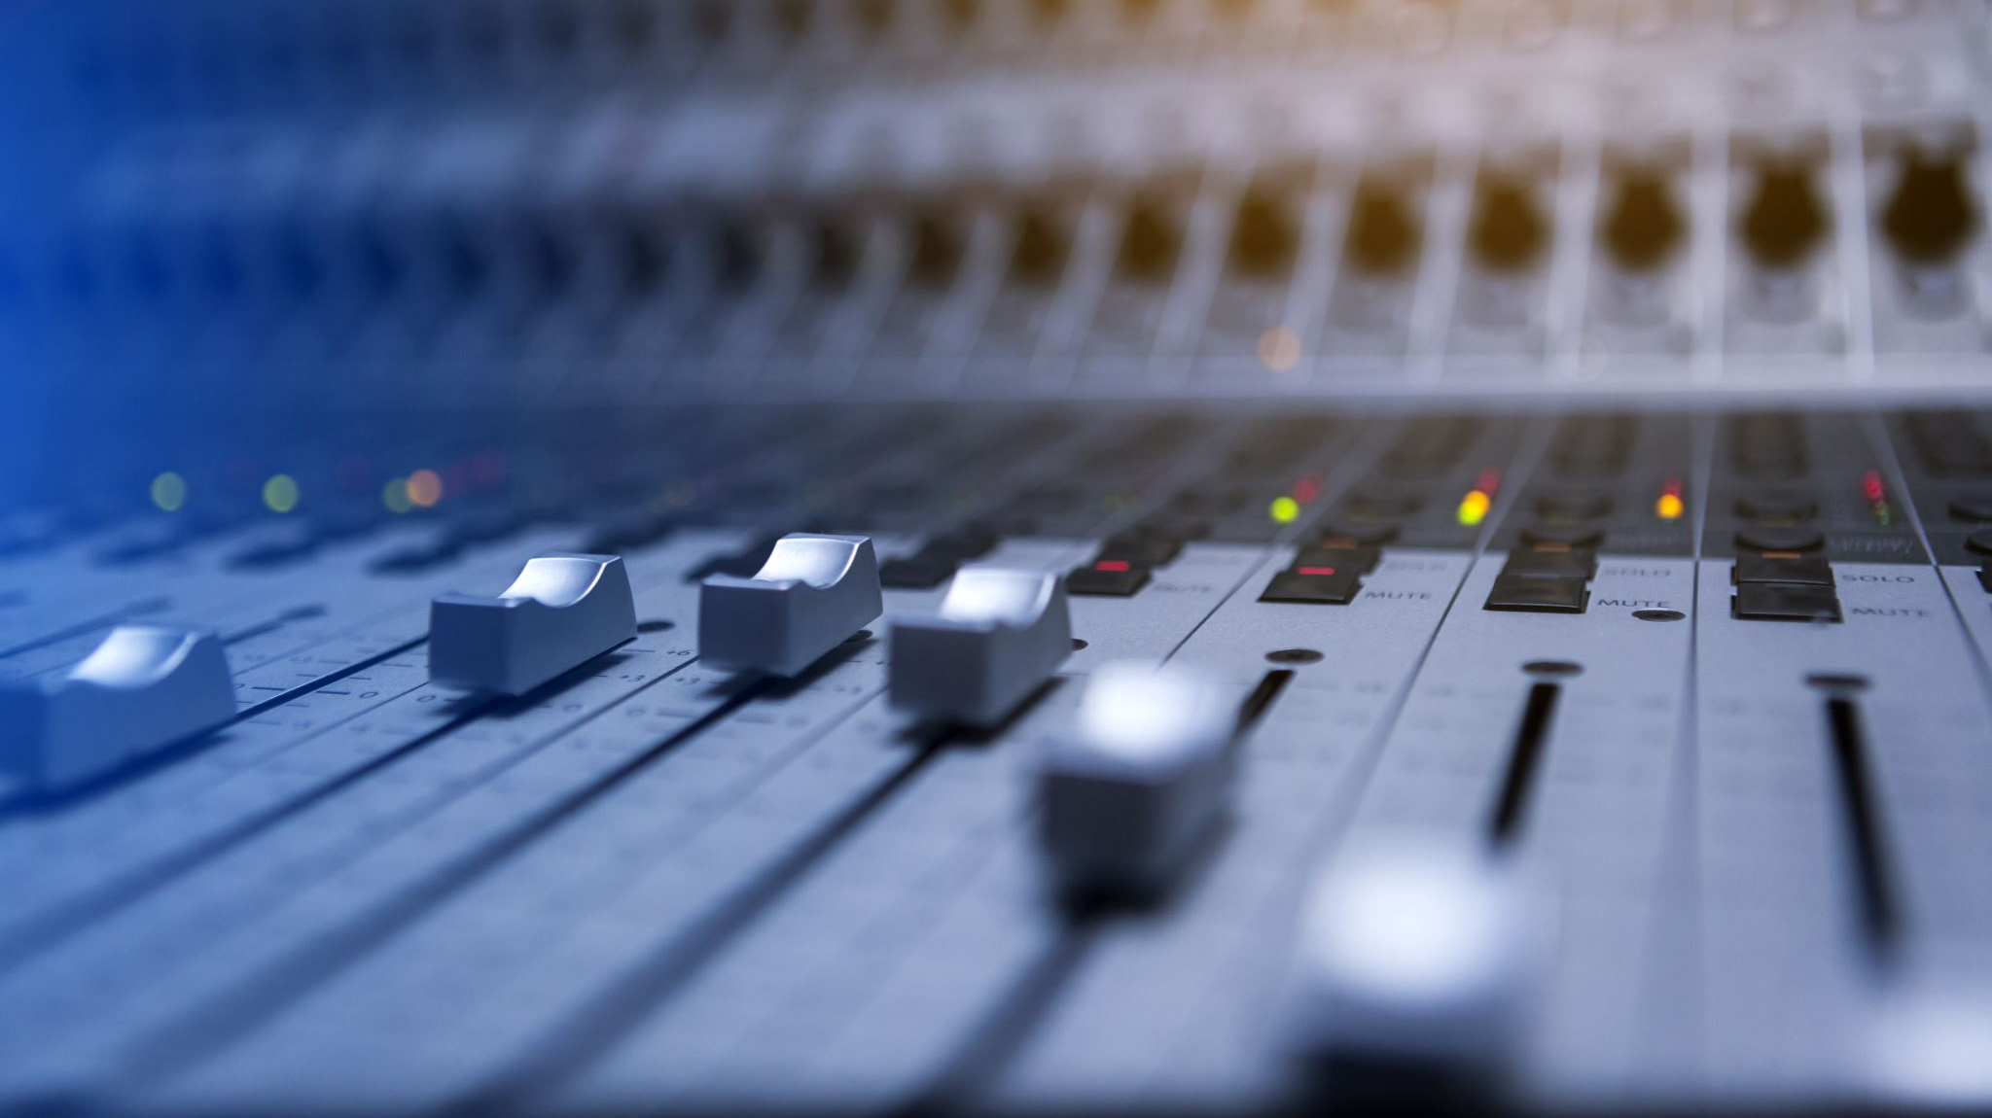
TAFGAN: Audio Super-Resolution using Time and Frequency Generative Adversarial Networks
Owen Santoso (22466085)

Slide 2
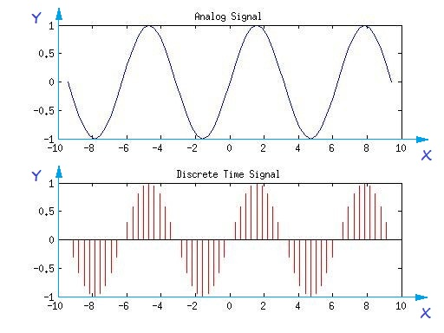
Digital Signal Processing
Signals in the real world are continuous
When working with signals on computers, we must discretise the signal by taking samples
Key parameters when converting from Analog to Digital signal is Sampling Rate and Bit Depth
Note: Bit depth is not the focus of our research project so it will not be covered.

Slide 3
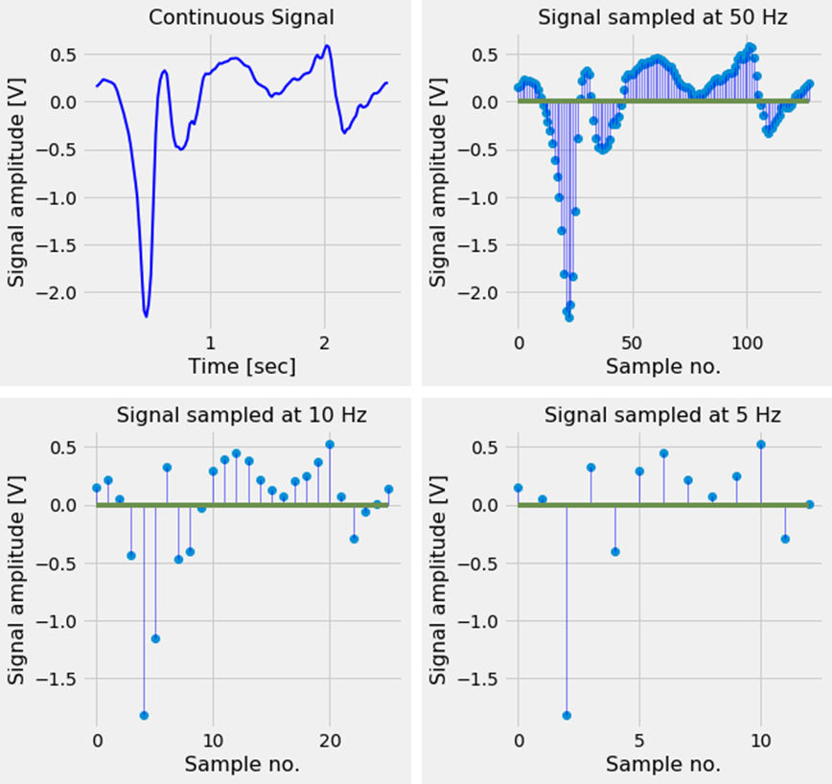
Sampling Rate
Depending on the amount (or rate) of samples, we trade space/bandwidth for higher fidelity
We call this the Sampling Rate
Due to bandwidth constraints, we typically choose the lowest sampling rate which is still acceptable
How do we know what the lowest we can use is?

Slide 4
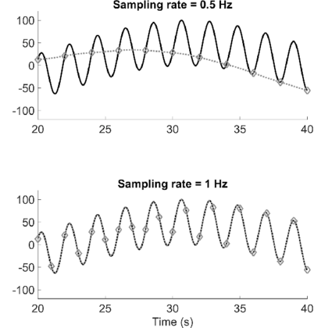
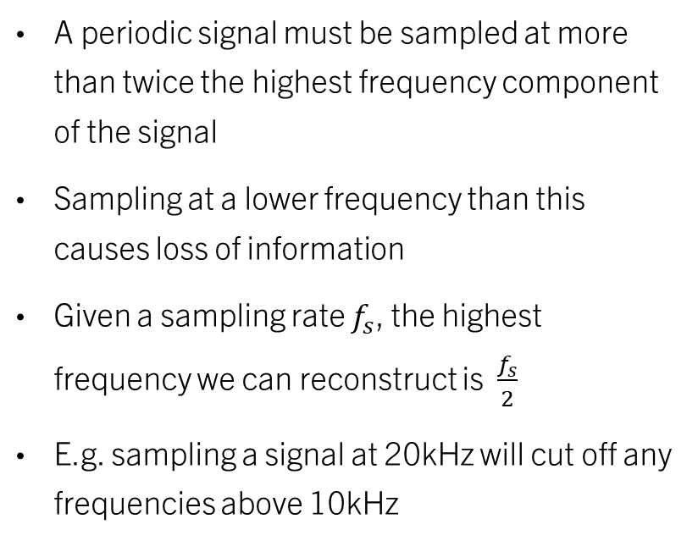
Nyquist Theorem
A periodic signal must be sampled at more than twice the highest frequency component of the signal
Sampling at a lower frequency than this causes loss of information
Given a sampling rate $f_{s}$, the highest frequency we can reconstruct is $\frac{f_{s}}{2}$
E.g. sampling a signal at 20kHz will cut off any frequencies above 10kHz

Slide 5
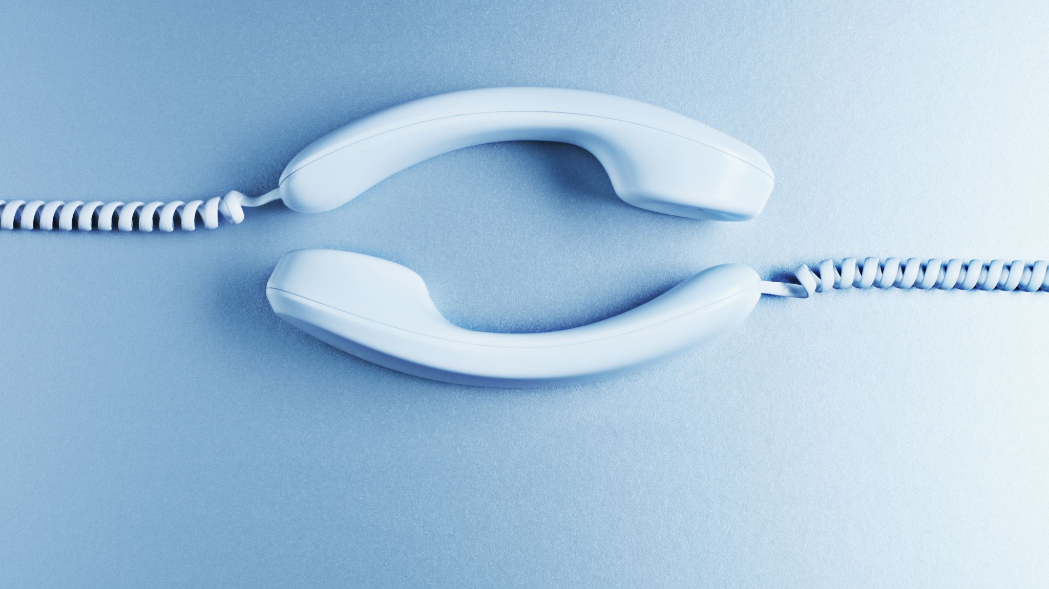
telephony
Human speech mostly falls under 4kHz, which is why 8kHz sampling rate is used for most legacy telephone lines
However, this degrades the audio quality, cutting off consonant sounds
Subpar telephone call quality → unintelligible speech

Slide 6
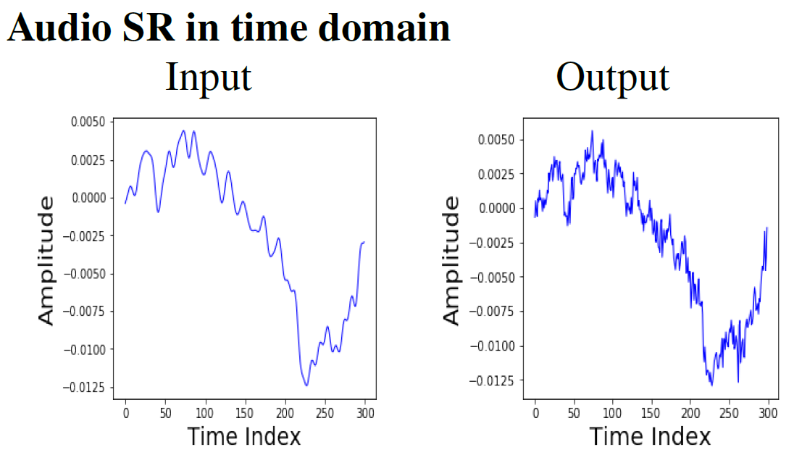
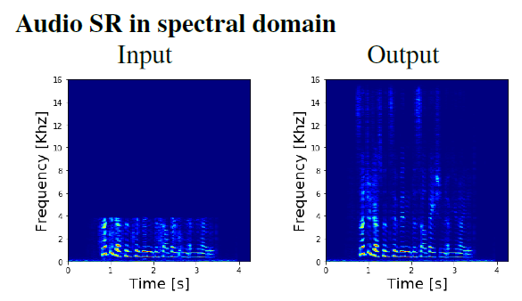
Audio Super-Resolution (ASR)
Transforming a low-resolution signal (low sampling rate) into a high-resolution signal (high sampling rate)
e.g. Taking a signal which was sampled at 8kHz (frequencies above 4kHz are cut off), and trying to recover the missing frequencies above 4kHz
Generate the missing high-frequency components
Notes:
Write notes

Slide 7
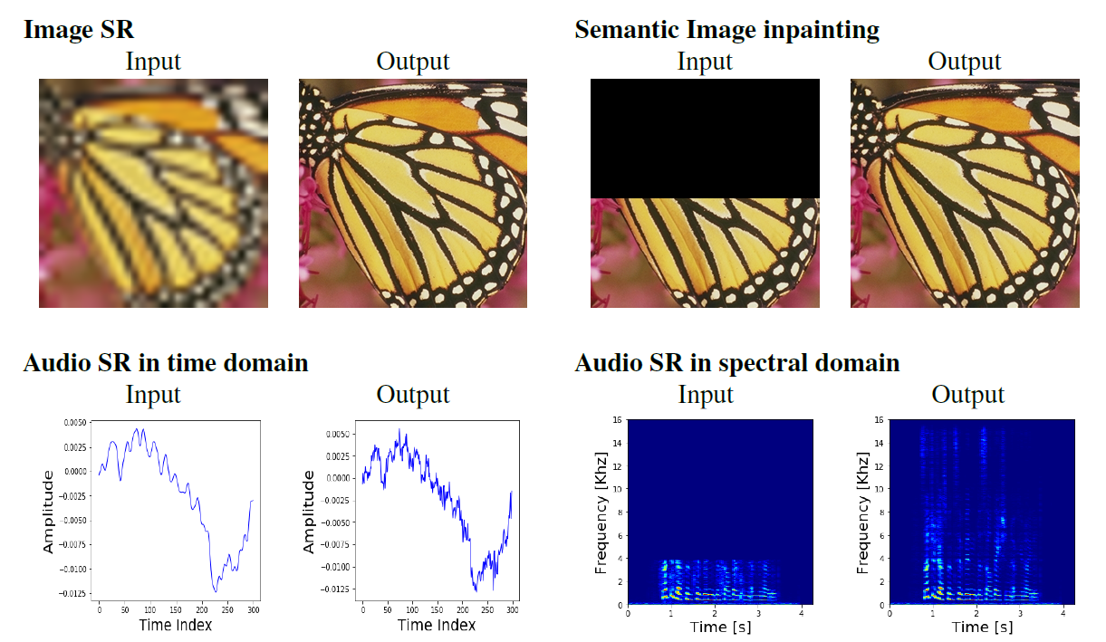
Blurry → Sharp
“Fill in the blank”
Notes:
Equivalent of audio sr but with images
Top left: Image Super Resolution
Input: low res, blurry image
Compressed
Right side: fill in the blanks

Slide 8
ASR in Telephony
Legacy transmission channels bottleneck the audio quality
Recreate higher bandwidth through software
ASR at communication nodes extend the bandwidth of a signal at the end-point
Notes:
How can ASR be used in telephony?
- Large-scale mobile communication infrastructure still contain many legacy transmission channels, which bottleneck the audio quality
- Using ASR, we can recreate the higher bandwidth through software
One possible application is ASR at communication nodes to extend the bandwidth of a signal at the end-point
Rather than upgrading all legacy transmission channels

Slide 9
Practical Uses of ASR
Telephony
Data compression
Forensics
Restoration of low-quality media
Text-to-speech pipelines
Notes:
As mentioned
Data compression
Could store or send data at lower resolutions to save space, then upscale when required
3. Forensics
E.g. Have some audio clip but it is low resolution, we could use ASR to increase quality
4. Restoration of low-quality media
- Old movies or songs which are lower quality could be restored to a high quality
5. Text to speech pipelines
- TTS engines e.g. google assistant or siri could generate lower resolution audio,

Slide 10
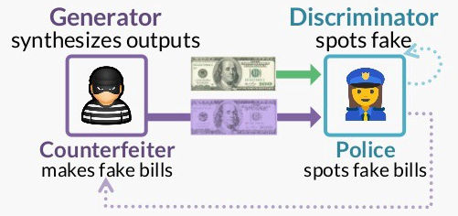
Generative Adversarial Network (GAN)
Type of deep learning neural network architecture
Consists of 2 competing networks: Generator and Discriminator
The goal of the generator is to create realistic outputs
The goal of the discriminator is to successfully differentiate between real outputs and fake, generated outputs

Slide 11
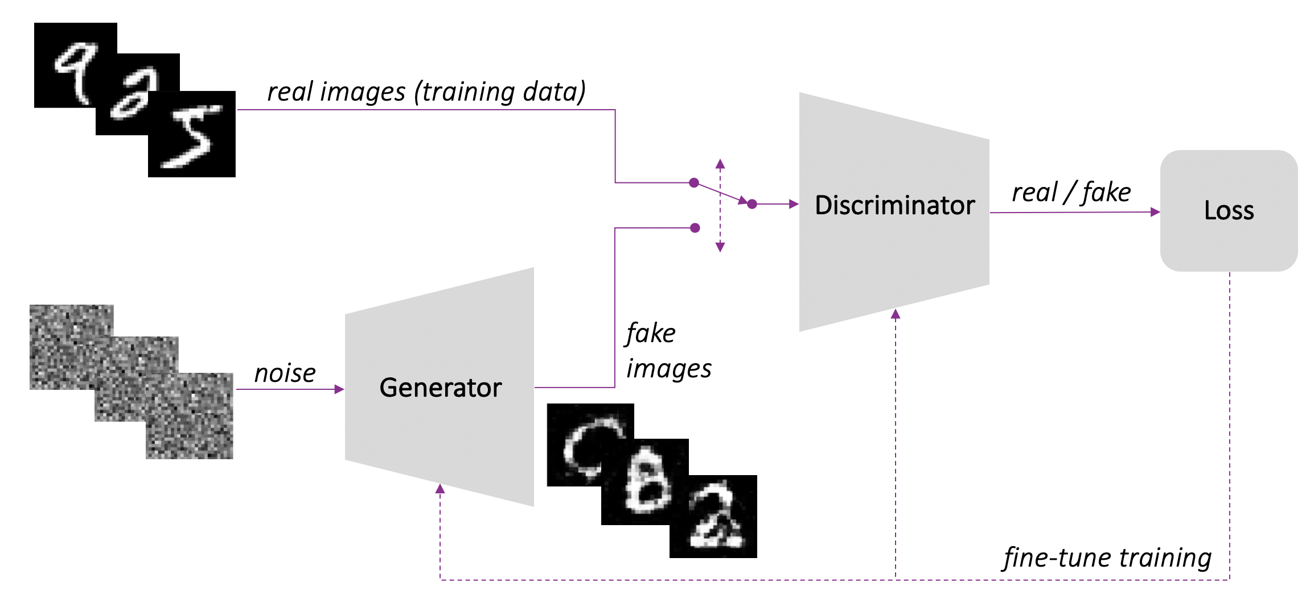
Generative Adversarial Network (GAN)
Real GAN example

Slide 12
GAN Successful Application
Deep learning techniques have seen great success in image super resolution and image synthesis tasks, currently leading the state-of-the-art.
GANs have been able to create incredibly lifelike photographs of fake people
Image on the right was created by Nvidia’s 2019 paper “StyleGAN2”
Notes:
Recently, neural network-based techniques have seen great success in image super resolution and image synthesis tasks, currently leading the state-of-the-art.
Specifically, generative adversarial networks (GANs) have shown large promise in their ability to fool even humans in image synthesis, creating incredibly lifelike photographs of fake people

Slide 13
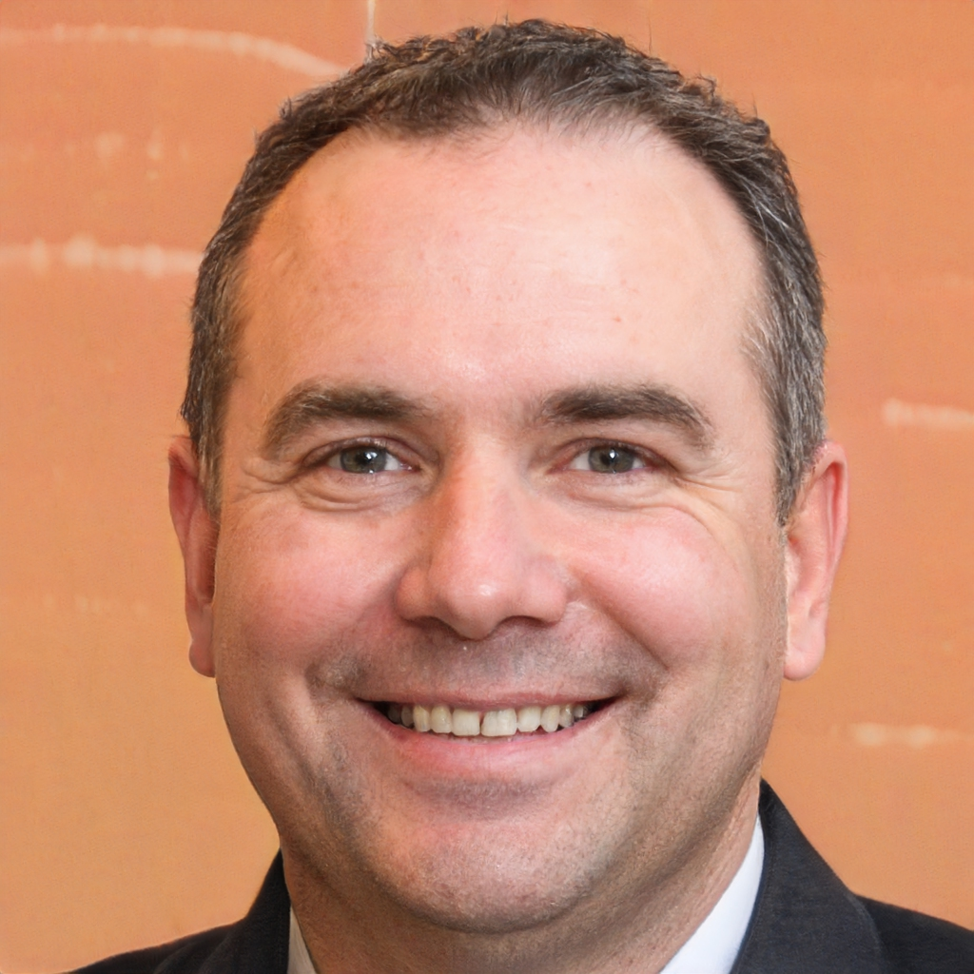
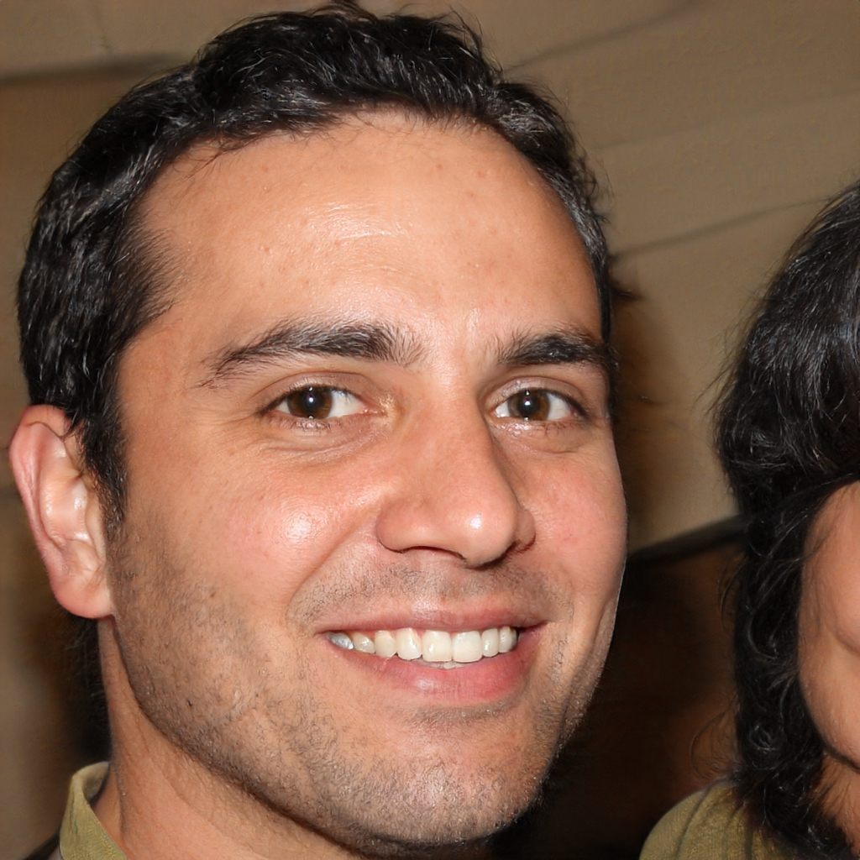
Which photo is fake?
Notes:
They were both created by Nvidia’s 2019 paper StyleGAN2
Shows how amazing GANs can be

Slide 14

Key Previous works
Lim et al. 2018 paper, “Time-Frequency Networks for ASR (TFNet)”
Showed that using a combination of time-domain and frequency-domain approaches with neural networks lead to significantly better results
Kumar et al. 2020 paper, “Neural Upsampling GAN”
Showed GANs can be successfully used in an ASR setting producing state-of-the-art results
Tian et al. 2020 paper, “Time-Frequency GAN Speech Synthesis”
Showed Time and Frequency approaches applied to GANs have promise in audio tasks
Notes:
-Lim et al in their 2018 paperTime-Frequency Networks for ASR (TFNet)”
Showed that using a combination of time-domain and frequency-domain approaches with neural networks lead to significantly better results
Kumar et al in their 2020 paper “Neural Upsampling GAN”
Showed GANs can be successfully used in an ASR setting producing state-of-the-art results
Tian et al. in their 2020 paper, “Time-Frequency GAN Speech Synthesis”
Showed Time and Frequency approaches applied to GANs have promise in audio tasks

Slide 15
Research Aim
Time-frequency models have shown SOTA results in ASR
GAN models also shown SOTA results in ASR
→ Combine the work of Lim et al’s Time and Frequency approach to ASR with a GAN model

Slide 16
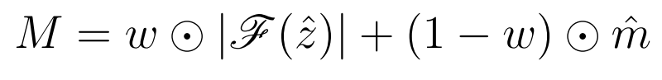
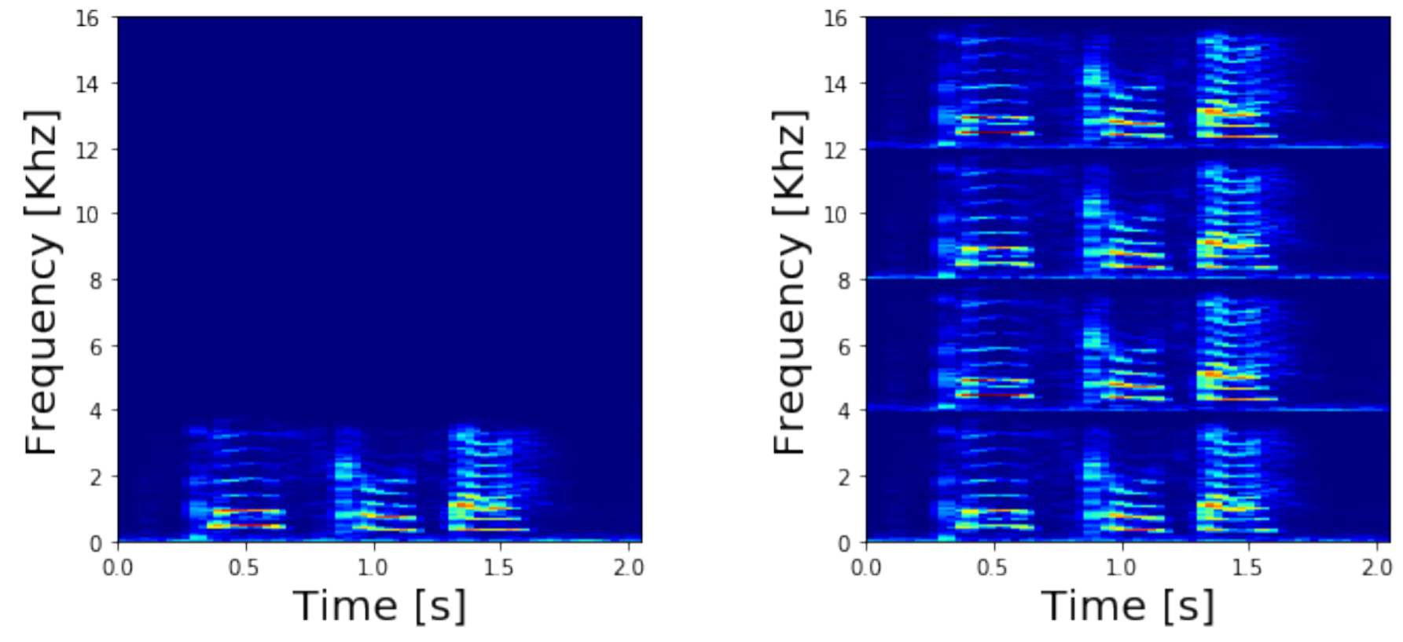

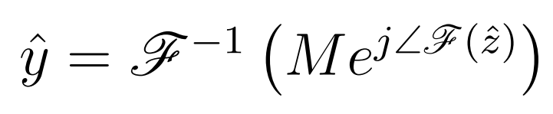
TFNet (Lim et al. 2018)
Spectral Fusion Layer
TFNet Architecture
Spectral Replicator
Combines outputs of the two branches. Phase is estimated only in the time domain.
The low-frequency components of the input spectrum are replicated three times in order to replace zeros in the high-frequency counterpart.
Spectral magnitude estimate
Final output estimate
Input
Output

Slide 17
Proposed Model

Slide 18
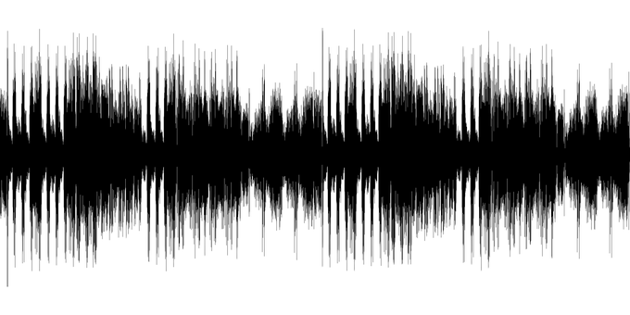
Dataset
VCTK Corpus: 44 hours of speech data uttered by 109 English speakers
48kHz sampling rate
Freely available online
All previous works used the same dataset
Only data from a single speaker is used due to time, hardware and computational power constraints

Slide 19


Software
Python
Widely used for deep learning
Easily accessible and free
Relatively simple syntax
Tensorflow
Package within python
Specifically tailored for deep learning and neural network applications
Lim et al. and other works

Slide 20
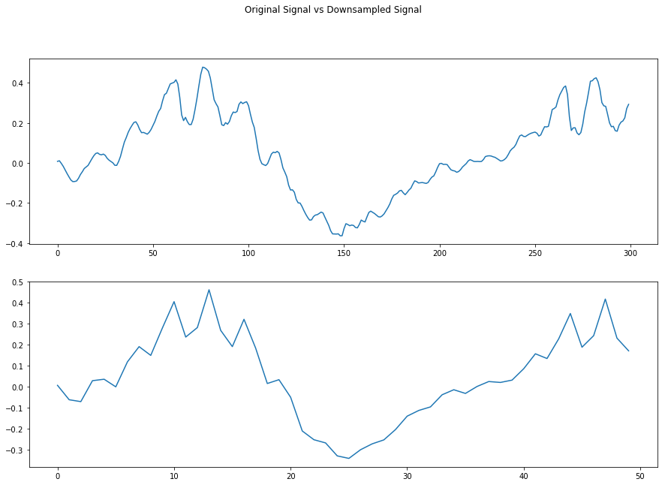
Data Preparation
Following the same methods as Lim et al.:
Apply low-pass filter to filter frequencies above 4kHz
Divide into 8192 sample length subsequences
Filter any “silent” subsequences
Downsample from 48kHz to 8kHz sampling rate (6x downsample)
Bicubic interpolation upsample
Amplitude
Sample Number

Slide 21
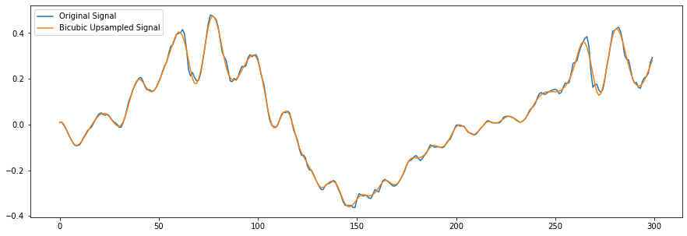
Downsampled Data plot
Amplitude
Sample Number

Slide 22
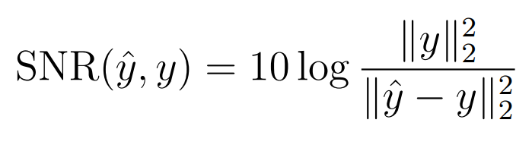
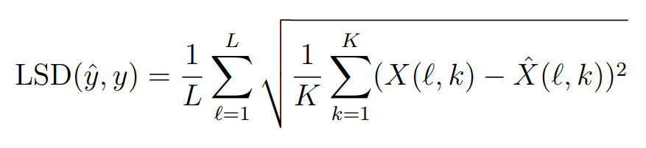
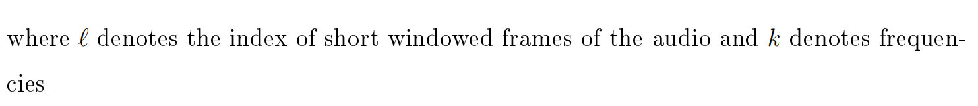
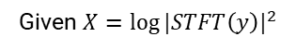
Evaluation Metrics
Signal to Noise Ratio (SNR)
Measures reconstruction quality in time-domain
Higher is better
Log Spectral Distance (LSD)
Measures reconstruction quality in frequency-domain
Lower is better
Given a reference signal $\text{y}$ and an approximation $\hat{y}$:
Given $X={log⁡|STFT\left(y\right)|}^{2}$

Slide 23
Problems Encountered
Due to difference in versions of code and operating systems, we had difficulties integrating Lim et al’s code
Frequency branch had negligible contribution compared to the time-domain branch
Lack of computational power required to fully train models until convergence

Slide 24
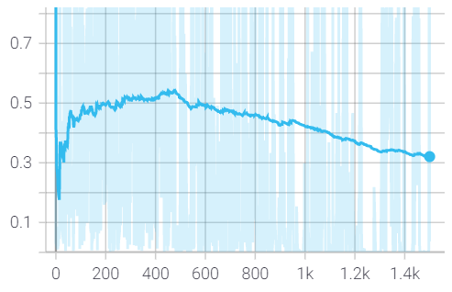
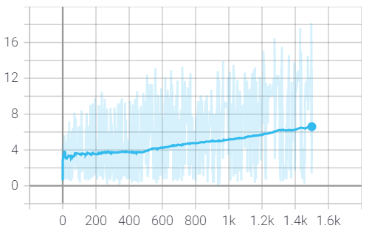
Network Training
Discriminator Loss
Generator Loss
Epochs
Epochs
Trained for 1,500 epochs
Losses haven’t converged yet
More training required
Other papers trained for up to 50,000 epochs
Notes:
An epoch is one ‘round’ of training

Slide 25
Results

Slide 26

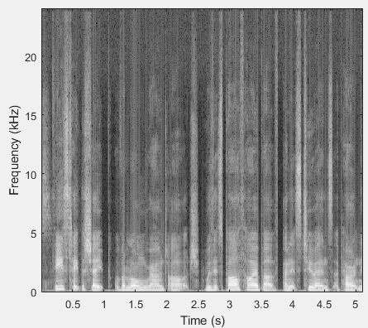
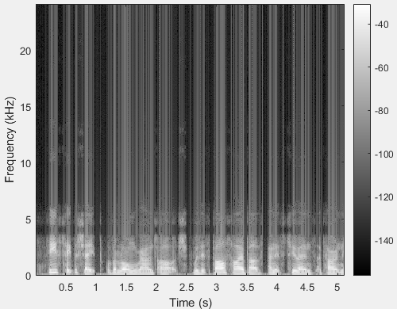
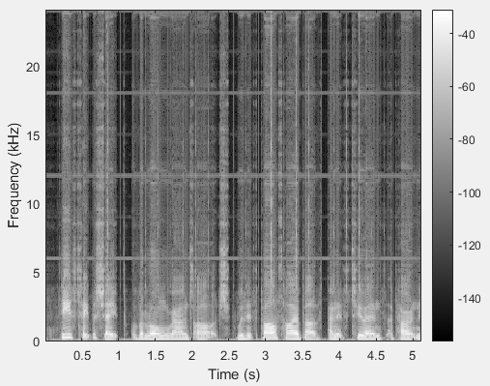
DEMO
“These take the shape of a long round arch, with its path high above, and its two ends apparently beyond the horizon. There is, according to legend a boiling …”
Original High-res
Low-res down-sampled
Generated signal

Slide 27
Conclusions
Our results showed similar performance to Lim et al’s original TFNet
Adding GAN architecture did not significantly improve results
However, further work could be explored in the topic of GANs, as we were time and hardware constrained

Slide 28

Further Work
Train for longer/use stronger hardware
Multiple GPUs rather than just one
Ablation study
Testing time and frequency branches separately
Include qualitative metrics based on human perception of audio quality
E.g. Perceptual Evaluation of Speech Quality (PESQ)
Conduct surveys
Implement different discriminator architectures
We used the pix2pix GAN’s default PatchGAN discriminator architecture
Notes:
Single RTX3080 was used for training, but parallelising can lead to much faster training
While SNR and LSD are good measures for objectively determining how similar an audio file is to the original
It is not very representative of human perception of audio quality

